Slide 1
Debugger Tutorial
ECE 0202

Slide 2
Starting the debugger
Start debug mode (with board plugged in)

Slide 3
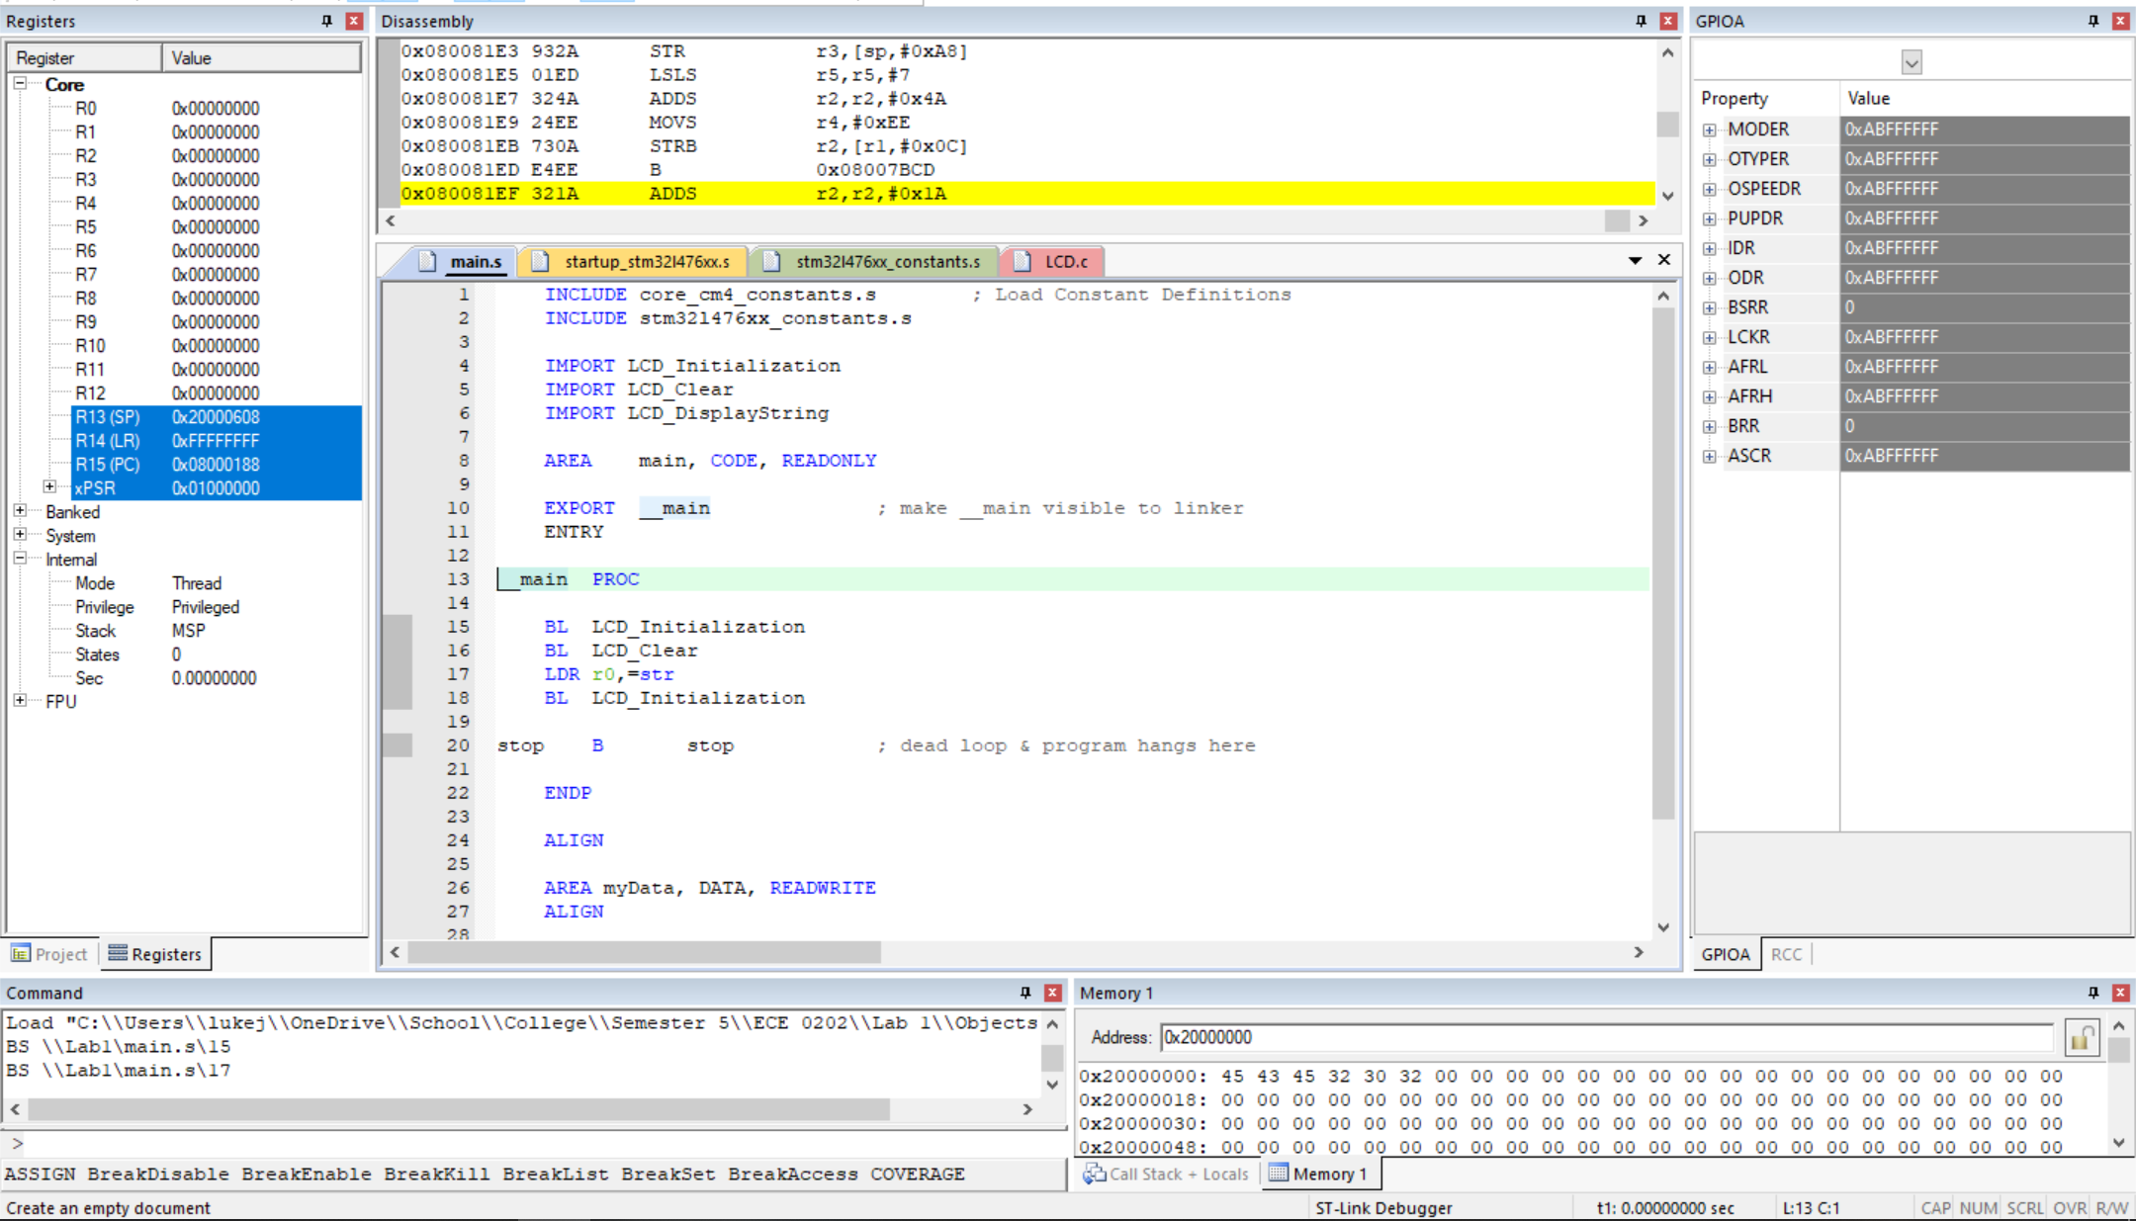
Layout
Disassembly
Code
Registers
GPIO Registers
Command Window
Memory Viewer

Slide 4
Navigation
Access GPIO Viewer
Exit Debug Mode
Remove all breakpoints
Run Program
Step one line
Run Until
Disable all breakpoints
Step Over
Step Out of
Stop program
Reset Board

Slide 5
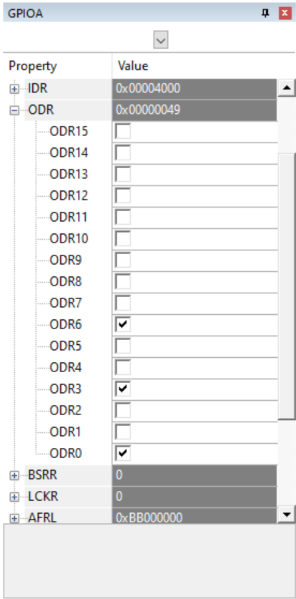
GPIO Viewer
Each GPIO’s registers
Individual bits in register

Slide 6
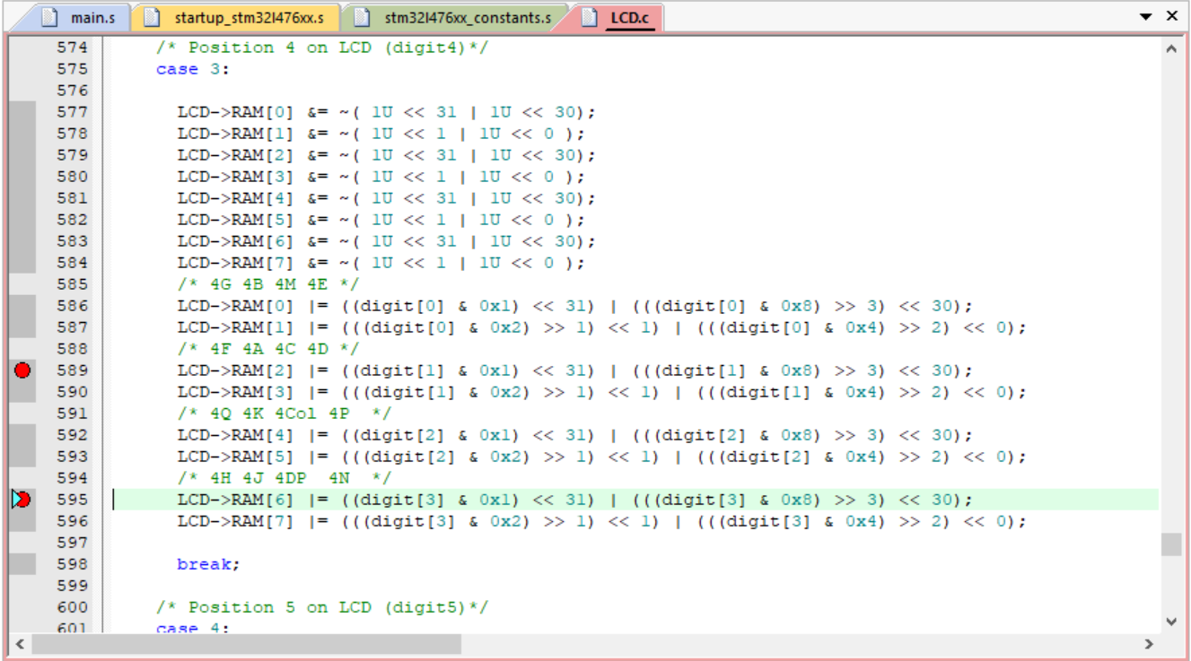
Adding Breakpoints
Click dark gray area
Breakpoint added here

Slide 7

Executing Code
Run
Executes the program until a breakpoint is hit
Stop
Stops the program at the next instruction to be executed
Reset
Stops the program and resets to the beginning

Slide 8

Stepping Through Code
Step
Executes a single instruction/line
Step Over
Executes a procedure/function and stops once it returns
Step Out Of
Continues until the current procedure/function returns
Step Until
Executes until a given line is hit

Slide 9
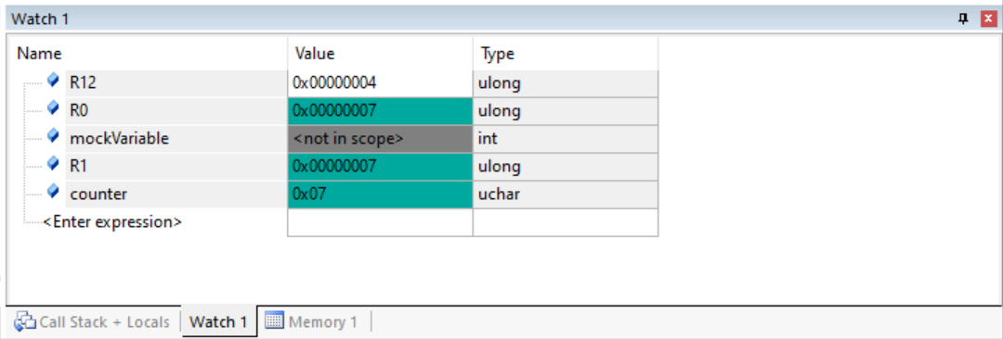
Watch Window
Can only view variables in scope
Enter Registers or Variables
Access from the View Menu

Slide 10
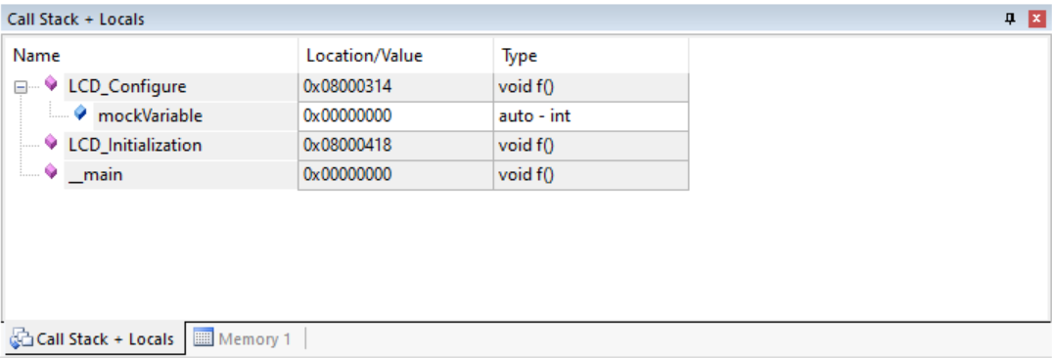
Call Stack & Locals
Variables allocated on the stack
Bottom of Stack
Accessable from View Menu

